Slide 1
Chapter 14

Slide 2
Objectives

Slide 3
Objectives (cont.)

Slide 4
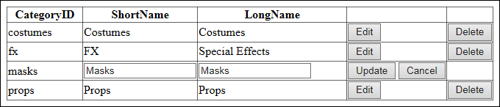
A GridView control that provides for updating a table

Slide 5
The aspx code for the GridView control

Slide 6
The aspx code for the GridView control (cont.)

Slide 7
Basic properties of the GridView control

Slide 8
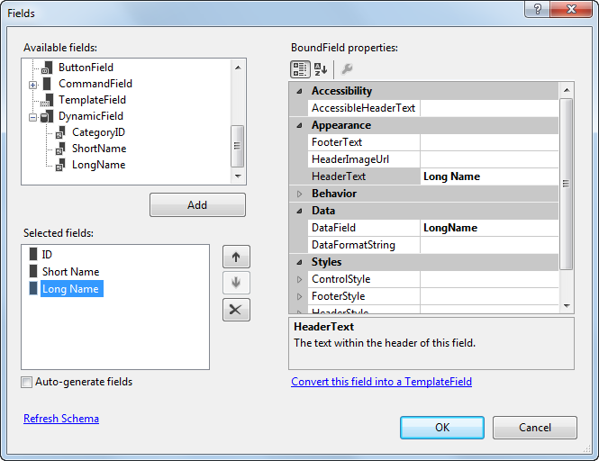
The Fields dialog box

Slide 9
Commonly used field properties

Slide 10
Column field elements

Slide 11
Style elements

Slide 12
The aspx code for a control that uses field and style elements

Slide 13
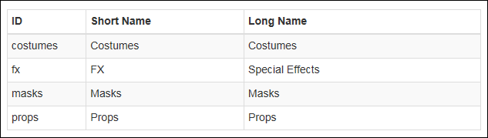
A GridView control that uses Bootstrap CSS classes for styling

Slide 14
The aspx code for the control

Slide 15
The PreRender event handler for the GridView control

Slide 16
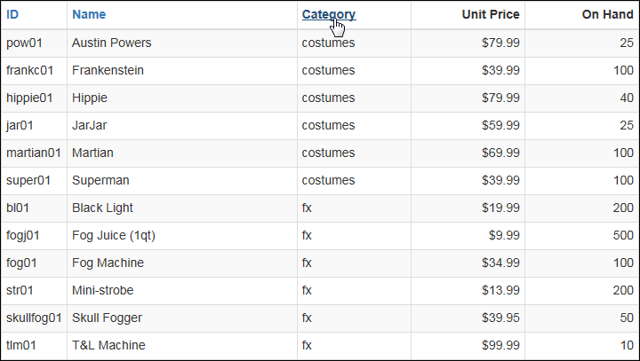
A GridView control with sorting enabled

Slide 17
The aspx code for the GridView control with sorting

Slide 18
The aspx code for the GridView control with sorting (cont.)

Slide 19
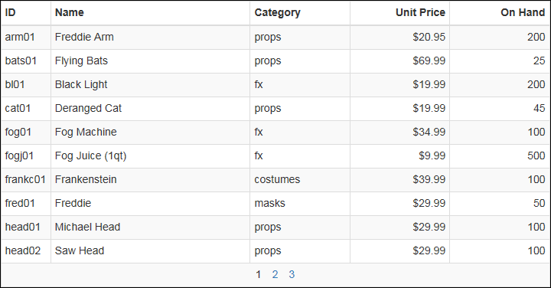
A GridView control with paging enabled

Slide 20
The aspx code for the GridView control with paging

Slide 21
The aspx code for the GridView control with paging (cont.)

Slide 22
Properties of the GridView control that affect paging

Slide 23
Properties of the PagerSettings element

Slide 24
A PagerSettings element
The resulting pager area

Slide 25
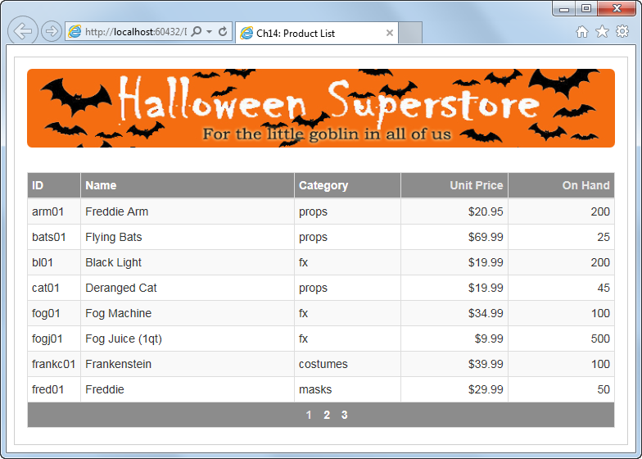
The Product List application

Slide 26
The body of the Default.aspx file

Slide 27
The body of the Default.aspx file (cont.)

Slide 28
The body of the Default.aspx file (cont.)

Slide 29
The event handler for the Prerender event of the GridView control

Slide 30
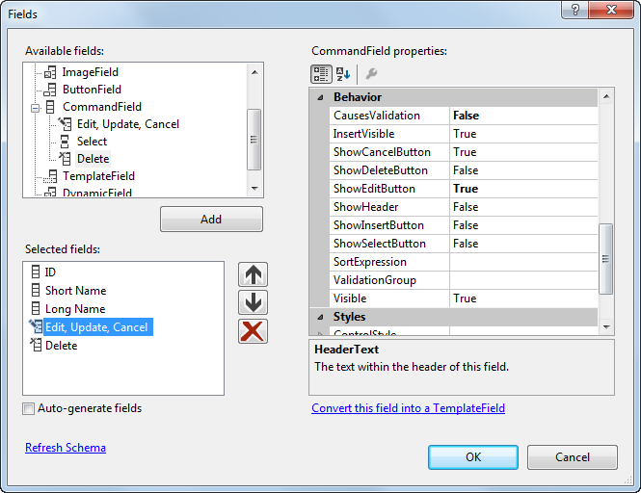
The Fields dialog box for working with a command field

Slide 31
Properties of the CommandField element

Slide 32
Properties that show buttons and set the text or images they display

Slide 33
Code that defines two command fields

Slide 34
Events raised by the GridView control

Slide 35
An event handler for the RowUpdated event

Slide 36
Method of the SqlDataSource class for inserting rows
Properties of the SqlDataSource class for inserting rows
Property of the Parameter class for inserting rows

Slide 37
Code that uses a SqlDataSource control to insert a row

Slide 38
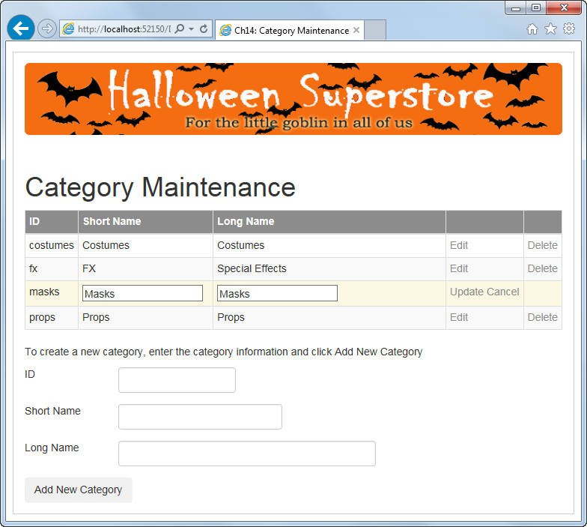
The Category Maintenance application

Slide 39
The body of the Default.aspx file

Slide 40
The body of the Default.aspx file (cont.)

Slide 41
The body of the Default.aspx file (cont.)

Slide 42
The body of the Default.aspx file (cont.)

Slide 43
The body of the Default.aspx file (cont.)

Slide 44
The body of the Default.aspx file (cont.)

Slide 45
The body of the Default.aspx file (cont.)

Slide 46
The Default.aspx.cs file

Slide 47
The Default.aspx.cs file (cont.)

Slide 48
The Default.aspx.cs file (cont.)

Slide 49
The Default.aspx.cs file (cont.)

Slide 50
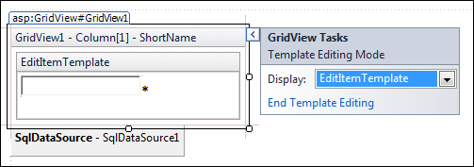
How to edit templates

Slide 51
GridView template elements

Slide 52
A template field that includes a validation control

Slide 53
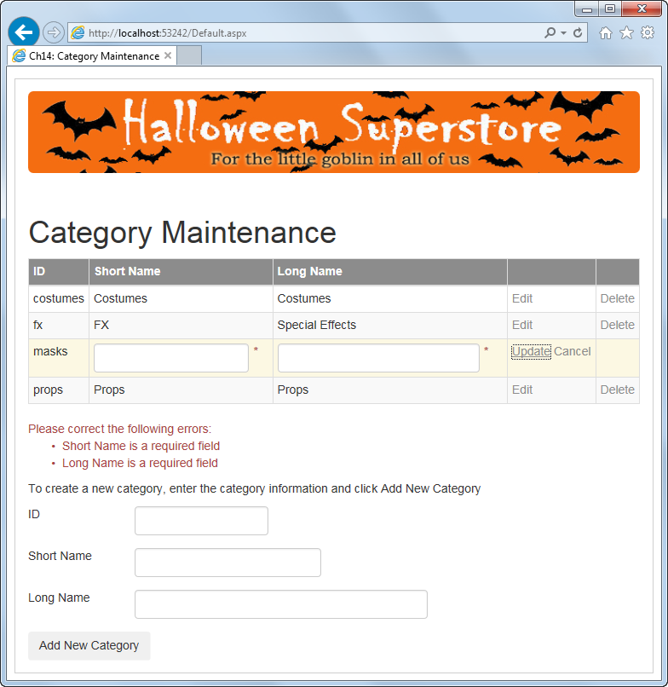
The Category Maintenance application with template fields

Slide 54
The Default.aspx file

Slide 55
The Default.aspx file (cont.)

Slide 56
The Default.aspx file (cont.)

Slide 57
The Default.aspx file (cont.)

Slide 58
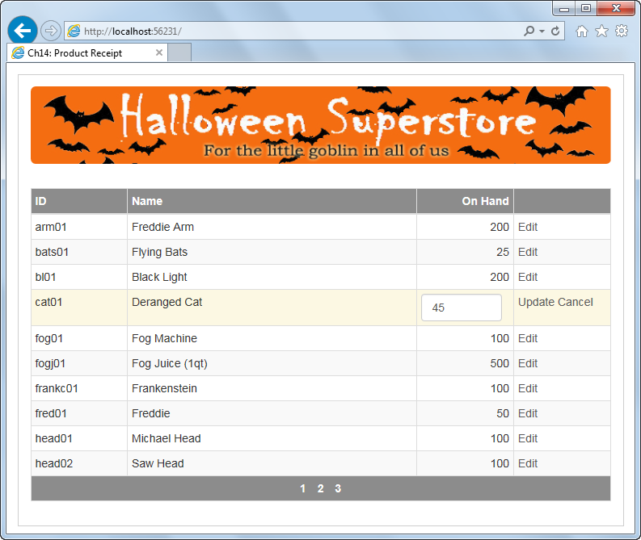
Extra 14-1 Create a Product Receipt application

